Slide 1
Introduction to Basic Electronics Lab

Slide 2
Platforms
1. http://vlabs.iitkgp.ernet.in/be/ (VLabs) 2. https://www.falstad.com/circuit/ (Falstad) 3. LT Spice

Slide 3
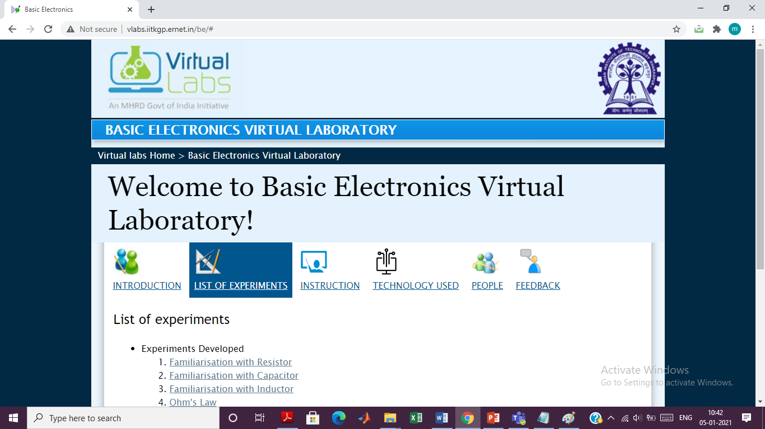
Vlabs ( http://vlabs.iitkgp.ernet.in/be/ )

Slide 4
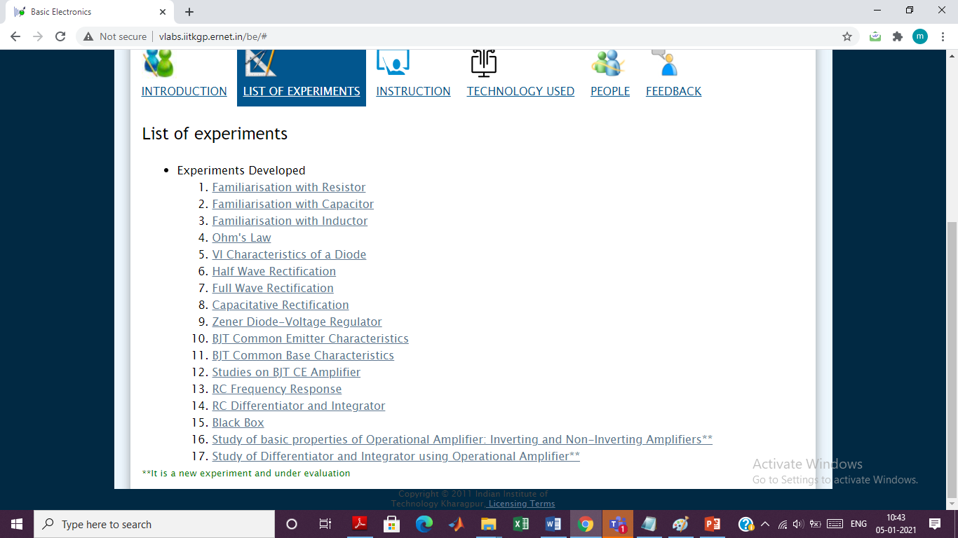
List of Experiments

Slide 5
